Slide 1
Olist store analysis
Group 4
Rahul Naskar
Vishwan Reddy
Pavan Mukesh Donga
Vinay Basava
Minati sahoo

Slide 2
Agenda
Objectives
Problem Statements
Approaches
KPI Analysis
Dashboard Design
Recommendation
Conclusion

Slide 3
Objective
Branch Dashboard to Discuss current year and previous year business numbers with E-Commerce Store.
This Dashboard will be discussed between corporate team and individual branch heads.
Discuss performance metrics in the branch.
Overall Performance Summary.
Key Insights and Action items.
Summary of Current Year and previous year business numbers for the country of Brazil

Slide 4
Problem Statements
Description of the Problem :
difficulty in connecting and analysing data across multiple sheets.
Challenges in establishing accurate one to many relationships in excel.
Issues with handling duplicate data entries.
Complication faced while uploading data into SQL database.
Background information and context :
The current process involves integrating data from various sources, often leading to the inconsistencies and errors.
Multiple data sheets are use, making it challenging to maintain data, integrity and streamline analysis.
Excel limitations in managing complex relationships and large data sets contribute to efficiencies.
The struggle to clean and prepare data before importing into a SQL hampers timely decision-making.

Slide 5
Approach followed to solve the KPI.
Tools and techniques used :
Pivot tables in excel- utilise to efficiently, summarise and analyse data for KPI calculations.
SQL Querying- executed complex square is to extract the manipulate data from the SQL database.
Power Bi- created additional columns to announce the data analysis capabilities.
Power query- employed to clean and transform data before importing into analytical tools.
Interactive visuals - develop, develop, interactive, dashboards, and visuals, using power via and tab for better Data representation and decision-making.

Slide 6
All the Kpi’s
List of key performance indicators (KPI)
Weekday vs weekend payment statistics -Average payment value : Weekday vs weekend
Total number of orders with Review Score 5 and Payment type as a credit card .
Average number of days taken for order delivery for pet shop .
Average price and payment values from customers of Sau Paulo city.
Relationship between shipping days and review scores . -Shipping days = order delivered, customer date - order purchase timestamp

Slide 7
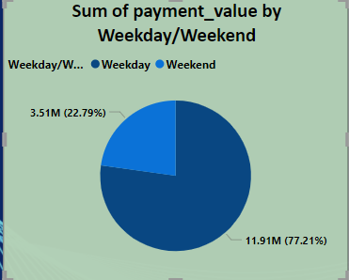
KPI-1

Slide 8
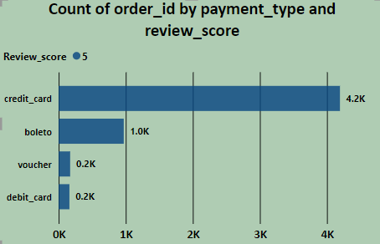
KPI-2

Slide 9
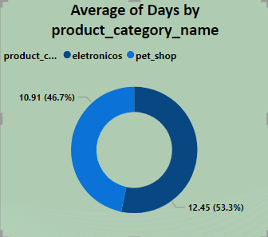
KPI-3

Slide 10
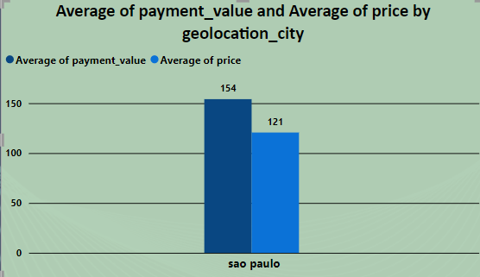
KPI-4

Slide 11
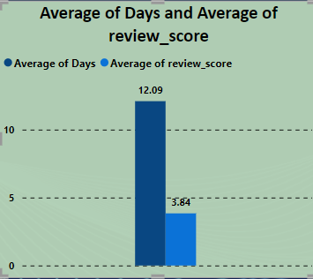
KPI-5

Slide 12
Detailed explanation of each KPI :
Weekday VS weekend payment statistics :- analysing the difference in order, volume and payment values between weekdays and weekends to identify peak shopping times and customer spending patterns.
Total number of orders which review score 5 and payment type as a credit card :- monitoring the number of top rated orders paid by credit card to assess customer satisfaction and preferred payment methods.
Average number of days taken for order delivery for pet shop :- calculating the average delivery time for pet shop, orders to evaluate efficiency and identify areas for improvement.
Average price and payment values from customers of Sao Paulo city :- determining the average order price and payment values from Sao Paulo city customers to understand regional spending behaviour.
Relationship between shipping days and review scores :- investigating how the duration of shipping impacts customer reviews, aiming to improve delivery times and enhance customers satisfaction.

Slide 13
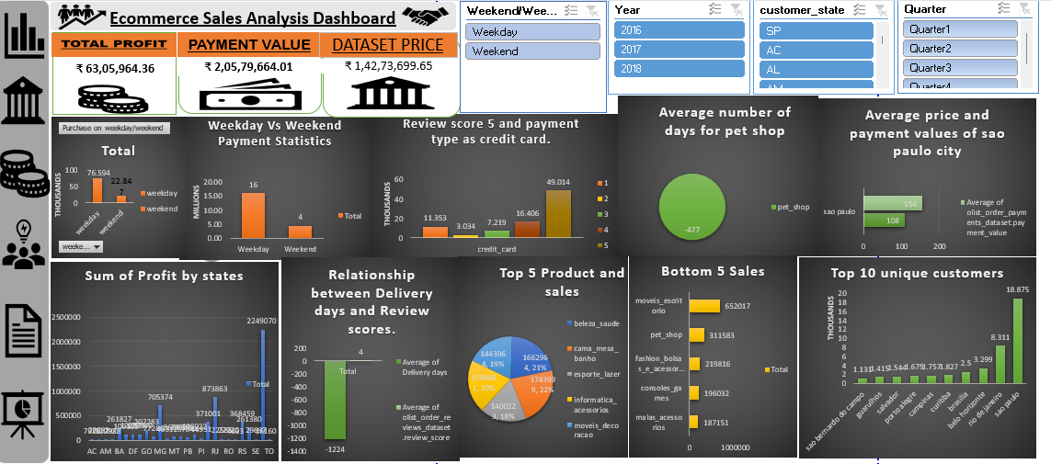
Excel olist Dashboard

Slide 14
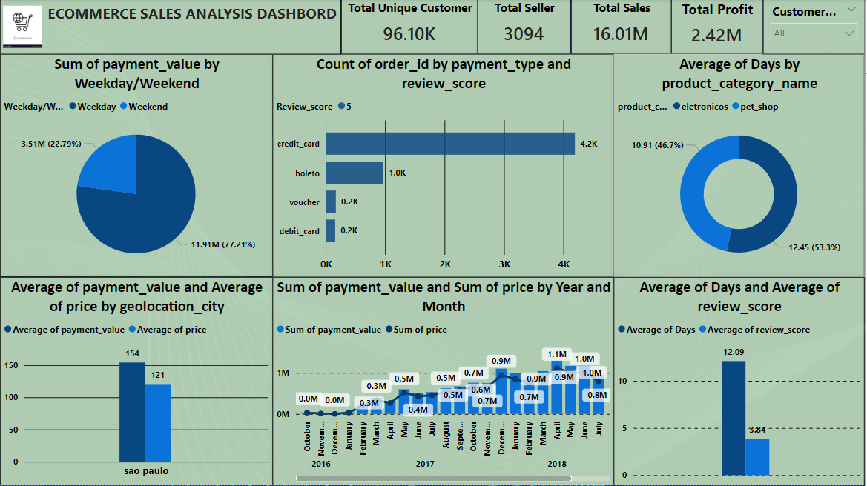
Power BI olist Dashboard

Slide 15
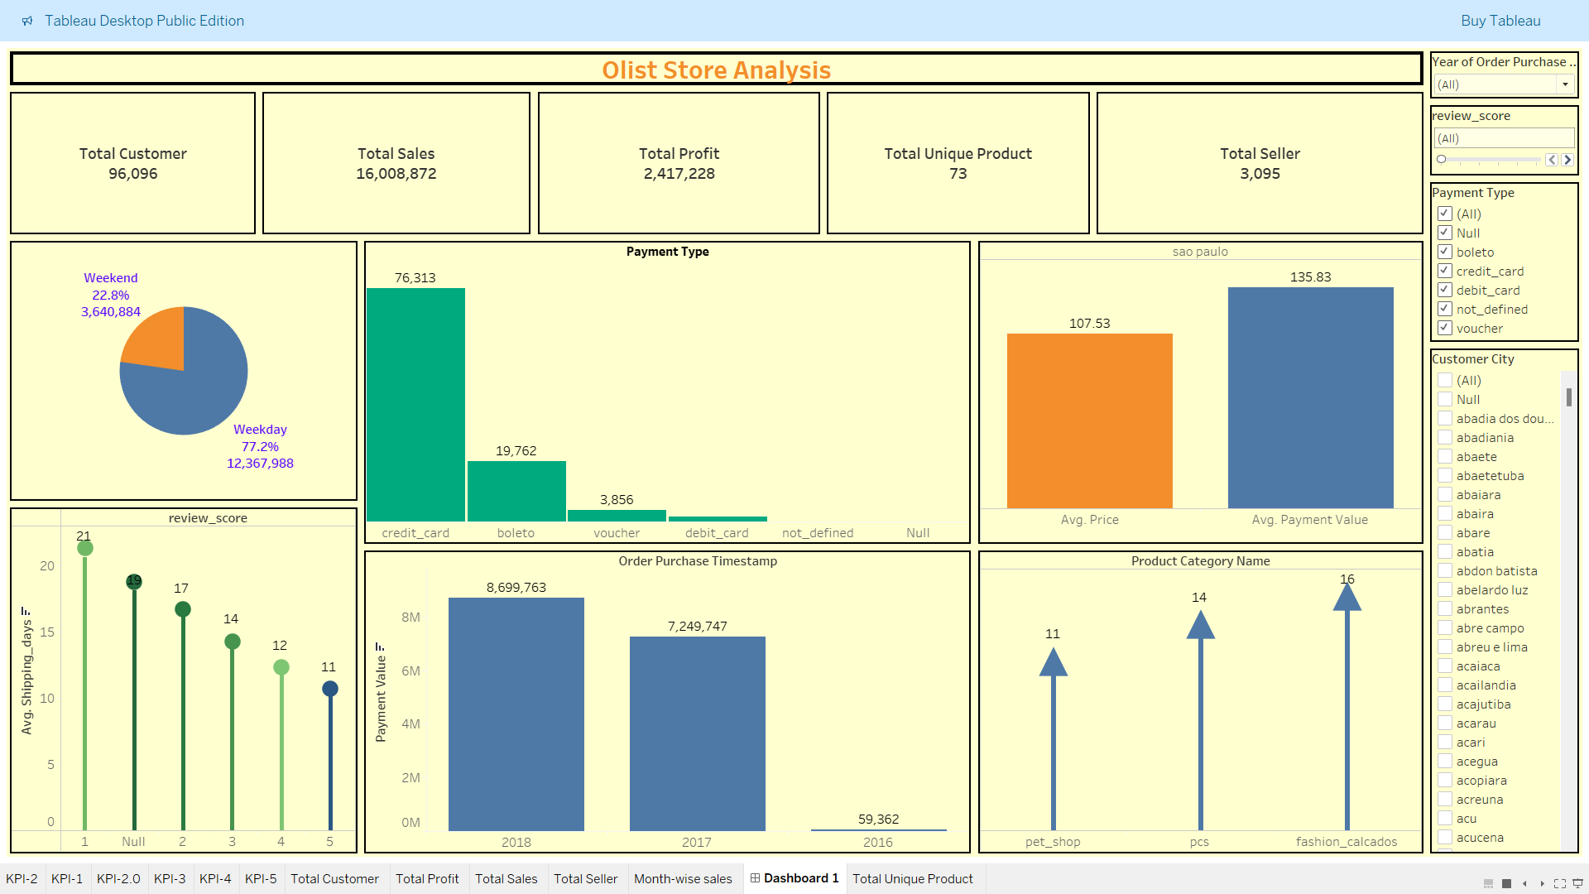
Tableau olist Dashboard

Slide 16
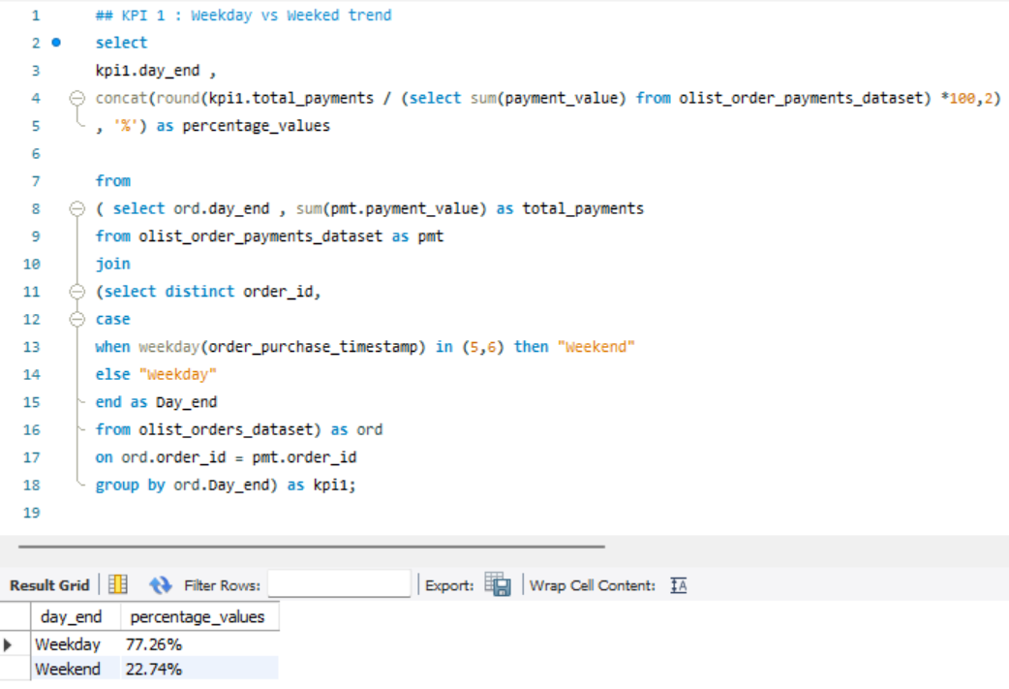
View in SQL

Slide 17
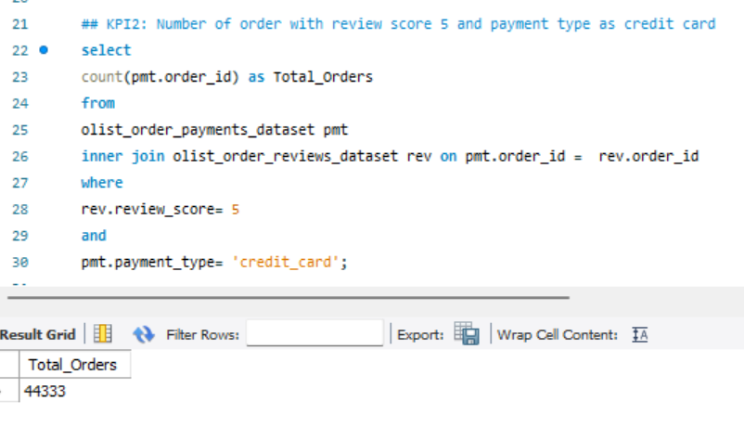
View in SQL

Slide 18
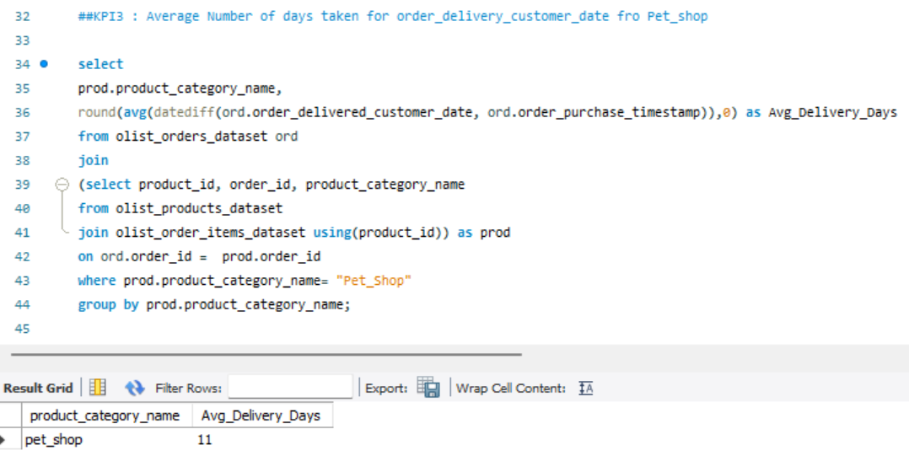
View in SQL

Slide 19
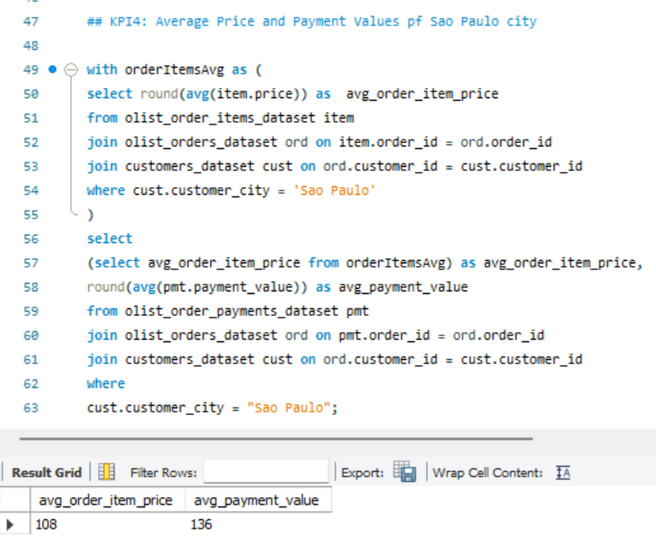
View in SQL

Slide 20
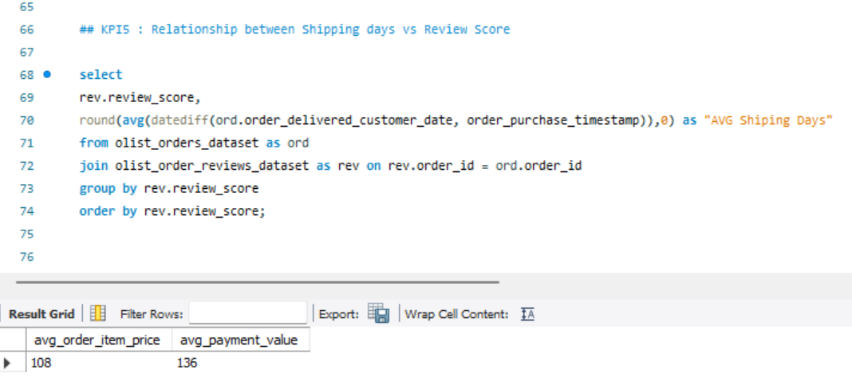
View in SQL

Slide 21
Recommendations
Investigate delivery delay and undelivered orders by analysing geographic locations could bring insights about certain challenges with demographics, accessibility, and possible route optimisation.
Tracking fleet performance.
Perform a detailed analysis of delivery locations to identify areas with frequent delays.
Optimise delivery routes using geographic information information system (GIS) to reduce delivery time.
Ensure that all parties involved in the delivery process have access to the same information to reduce miscommunication .

Slide 22
Thank You

